Slide 1
Chapter 2: Physical Layer (Part 2)
Source: CN5E by Tanenbaum & Wetherall, © Pearson Education-Prentice Hall and D. Wetherall, 2011
COSC 439: Computing Network Principles

Slide 2
Chapter 2 (Part 2) focuses on:
Theoretical Basis for Data Communications
Digital Modulation
Public Switched Telephone Network
COSC 439: Computing Network Principles
Notes:
This chapter covers topics related to the generation and representation of data. It covers the various schemes used to represent digital data as digital signal, representation of digital data as analog signals using Fourier’s approximations, how to determine the bit rate of a transmission link based on the allocated bandwidth and data representation, converting digital data into analog signal, converting analog data into digital signal and modems including dial-up, cable and DSL standards.
→ Next slide

Slide 3
Terminology
Analog Signals: Represented by the sine function, characterized by its frequency, amplitude, and phase shift
Signal Period: the time it takes to complete a signal pattern once
Frequency: the number of times the signal oscillates per unit of time
Amplitude: defines the values between which the signal oscillates
Phase shift: a horizontal shift in the graph of a sine function
COSC 439: Computing Network Principles
Notes:
The following terminology are used to describe an analog signal.
An analog signal may be represented by the function:
s(t) = A sin (ft + θ)
where: A is the amplitude, f is the frequency, and θ ισ τηε πηασε σηιφτ.
→ Next slide

Slide 4
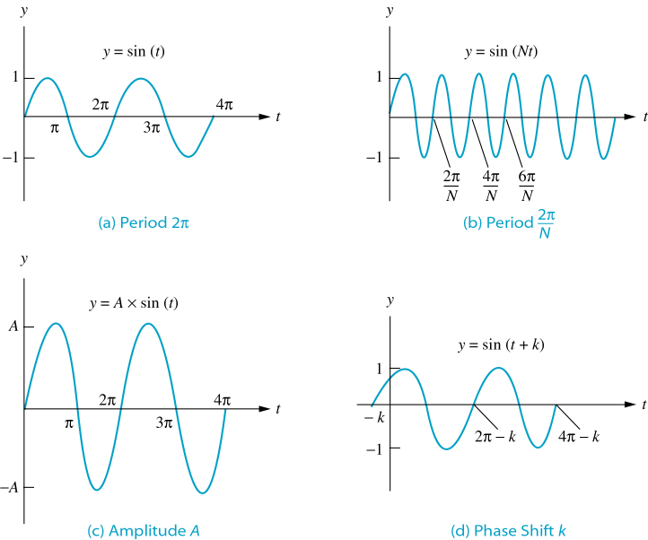
Analog Signals
COSC 439: Computing Network Principles
Notes:
This illustrates an analog signal with varying period (frequency), amplitude, or phase.
→ Next slide

Slide 5
Theoretical Basis for Data Communication
Communication rates have fundamental limits
  Fourier analysis »
  Bandwidth-limited signals »
  Maximum data rate of a channel »
CN5E by Tanenbaum & Wetherall, © Pearson Education-Prentice Hall and D. Wetherall, 2011

Slide 6
Fourier’s Result
Any periodic function can be expressed as an infinite sum of sine functions of varying amplitude, frequency, and phase shift (called the Fourier series).
COSC 439: Computing Network Principles
Notes:
The Fourier series allows us to express any periodic function as an infinite sum of sine functions of varying amplitude, frequency, and phase shift.
→ Next slide

Slide 7
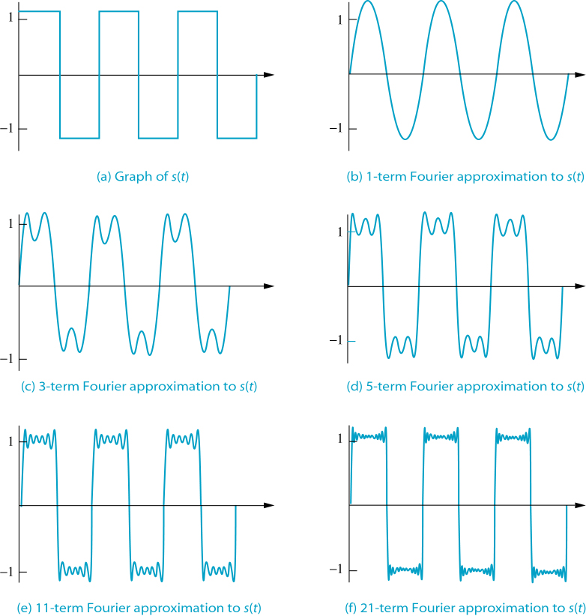
Fourier Approximations
COSC 439: Computing Network Principles
Notes:
The figure illustrates how a sum of sine functions of varying amplitude, frequency, and phase shift, can approximate a periodic signal.
→ Next slide

Slide 8
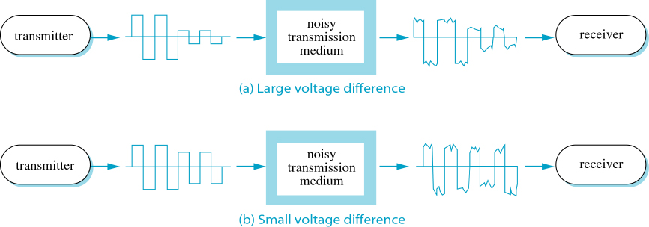
Effect of noise on Digital Signals
COSC 439: Computing Network Principles
Notes:
This illustrates how noise affects the received signal if the difference between the levels used by the transmitter to represent data values is either large or small. Note that noise does not completely destroy the data if there is a large difference between the voltage representations of different data values.
→ Next slide

Slide 9
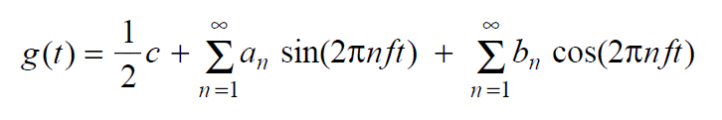
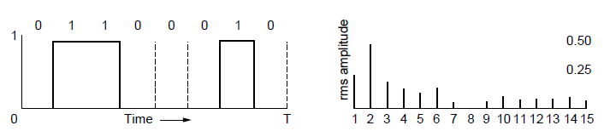
Fourier Analysis
A time-varying signal can be equivalently represented as a series of frequency components (harmonics):
=
Signal over time
a, b weights of harmonics
CN5E by Tanenbaum & Wetherall, © Pearson Education-Prentice Hall and D. Wetherall, 2011

Slide 10
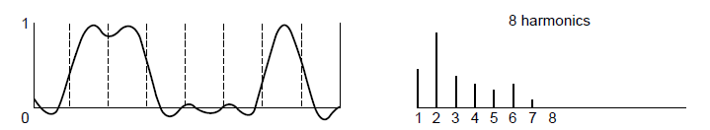
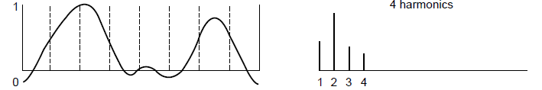
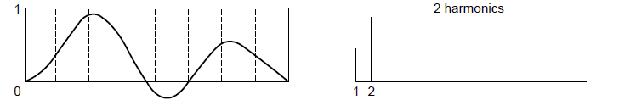
Bandwidth-Limited Signals
Having less bandwidth (harmonics) degrades the signal
8 harmonics
Lost!
Bandwidth
4 harmonics
Lost!
2 harmonics
Lost!
CN5E by Tanenbaum & Wetherall, © Pearson Education-Prentice Hall and D. Wetherall, 2011

Slide 11
Bit Rate vs Baud Rate
Bit rate (bps)
  Measure of the number of bits that can be transmitted per unit of time
Baud rate
  The frequency with which the signal components change
COSC 439: Computing Network Principles
Notes:
Bit rate is a measure of the number of bits that can be transmitted per unit of time while baud rate is defined by the frequency with which the signal components change. Given a baud rate of 2400 baud (Hz), that is, 2400 signal components (or cycles) per second, and an encoding scheme that carries 1 bit per signal component (cycle), then the corresponding bit rate is:
Bit rate = 1 (bit/cycle) * 2400 (cycles/second) = 2400 bits/second
If we take the Manchester encoding scheme where the bit rate per cycle is ½, then using the same baud rate, the corresponding bit rate is:
Bit rate = (1/2 bits/second) * 2400 (cycles/second) = 1200 bits/second
The increase in bit rate capacity for a transmission medium with the same baud rate available can be attributed to the encoding scheme used that could represent multiple bits in a single signal component. We will cover examples of these is our discussion on digital to analog conversion.
→ Next slide

Slide 12
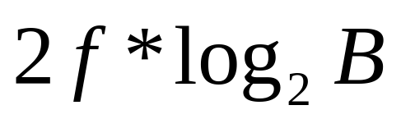
Nyquist’s Theorem
Bit rate =
Where:
  B: number of different components
  f: maximum frequency
COSC 439: Computing Network Principles
Notes:
Nyquist’s theorem allows us to calculate the bit rate generated for a given frequency and the number of different components or levels of data used in the encoding. The log₂B component corresponds to the number of bits per cycle used in the encoding.
For example, the human voice has a maximum of 4KHz (4 x10³ Hz) frequency. If we use 256 different levels of data to represent each voice sample, we will generate a total bit rate of
Bit rate = 2 * 4000 Hz * log₂ (256) bits/cycle = 8000 cycles/second * 8 bits = 64000 bits/second
This 64 Kbps bit rate is maximum bit rate capacity that common phone lines can carry, hence, voice grade.
Nyquist’s formula can also be used to determine the maximum bit rate capacity of a transmission medium, given the available bandwidth and the number of bits used per cycle. If a transmission medium has a bandwidth of 10 MHz and uses 16 bits per cycle, then the resulting bit rate capacity is:
Bit rate = 2 * 10 x 10⁶ Hz * 16 bits/ cycle = 320 Mbps
→ Next slide

Slide 13
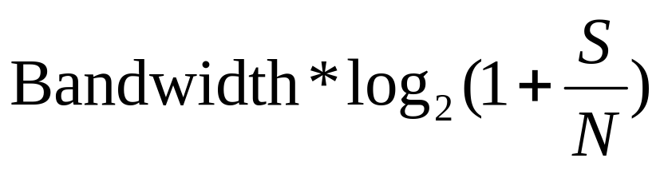
Shannon’s (Noisy) Theorem
Bit rate =
Where:
  S/N: signal-to-noise ratio
S/N conversion from decibel units:
dB = 10 * log₁₀ (S/N)
S/N = 10^{dB/10}
COSC 439: Computing Network Principles
Notes:
Shannon’s theorem includes the existence of noise in calculating the bit rate. Noise
S/N is the ratio between the signal strength and the noise strength. This ratio is unit-less. However, if this ratio is given in decibel () units, then it is of the form 10 * log10 (S/N).
Therefore, given a signal to noise ratio in dB, one must first calculate the unit-less S/N. For example, given a signal-to-noise ratio of 10dB, the corresponding S/N value is:
S/N = 10^{dB/10}
To calculate the bit rate for a given bandwidth = 100 MHz and a signal-to-noise ratio of 30 dB,
S/N = 10^{30/10} = 10³ = 1000
Bit rate = 100x10⁶ Hz * log₂(1+S/N) bits
= 100x10⁶ Hz * log₂ (1+ 1000) bits
= 100x10⁶ Hz * (log₁₀ (1+ 1000) / log₁₀ 2) // Note: If your calculator does not have a log2 function, you can use log₂ x = log₁₀ x / log₁₀ 2
= 996.7 Mbps

Slide 14
Maximum Data Rate of a Channel
Nyquist’s theorem relates the data rate to the bandwidth (B) and number of signal levels (V):
Shannon's theorem relates the data rate to the bandwidth (B) and signal strength (S) relative to the noise (N):
Max. data rate = 2B log₂V bits/sec
Max. data rate = B log₂(1 + S/N) bits/sec
How fast signal
can change
How many levels
can be seen
CN5E by Tanenbaum & Wetherall, © Pearson Education-Prentice Hall and D. Wetherall, 2011
Notes:
These are fundamental limits; real systems can only approach them.
S/N is called the signal to noise ratio SNR, and it is commonly measured in decibels on a logarithmic scale e.g., 10dB means the signal is 10X noise, 20dB means 100X noise, etc.

Slide 15
Digital Modulation
Modulation schemes send bits as signals.
  Baseband Transmission »
  Passband Transmission »
CN5E by Tanenbaum & Wetherall, © Pearson Education-Prentice Hall and D. Wetherall, 2011

Slide 16
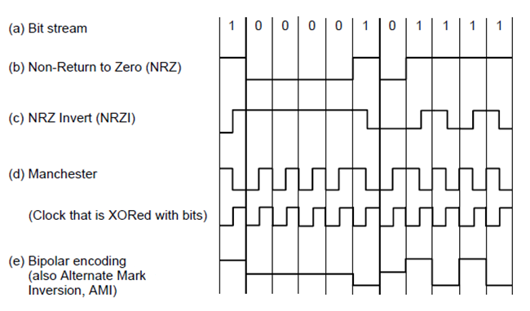
Baseband Transmission
Line codes send symbols that represent one or more bits
  NRZ is the simplest, literal line code (+1V=“1”, -1V=“0”)
  Other codes tradeoff bandwidth and signal transitions
Four different line codes
CN5E by Tanenbaum & Wetherall, © Pearson Education-Prentice Hall and D. Wetherall, 2011

Slide 17
Clock Recovery
To decode the symbols, signals need sufficient transitions
  Otherwise long runs of 0s (or 1s) are confusing, e.g.:
Strategies:
  Manchester coding, mixes clock signal in every symbol
  4B/5B maps 4 data bits to 5 coded bits with 1s and 0s:
  Scrambler XORs tx/rx data with pseudorandom bits
1
0 0 0 0 0 0 0 0 0 0 um, 0? er, 0?
Data | Code | Data | Code | Data | Code | Data | Code
0000 | 11110 | 0100 | 01010 | 1000 | 10010 | 1100 | 11010
0001 | 01001 | 0101 | 01011 | 1001 | 10011 | 1101 | 11011
0010 | 10100 | 0110 | 01110 | 1010 | 10110 | 1110 | 11100
0011 | 10101 | 0111 | 01111 | 1011 | 10111 | 1111 | 11101
CN5E by Tanenbaum & Wetherall, © Pearson Education-Prentice Hall and D. Wetherall, 2011
Notes:
Strategies go from simplest to more complex and make progressively better use of bandwidth:
-Manchester is simple (every symbol has an embedded transition) but uses twice the bandwidth of a data signal
-4B/5B ensures no more than three 0s in a row (1s can be handled by making the signal level change to represent a 1) and needs 1.25X bandwidth
-scrambler needs no extra bandwidth (just data XOR sequence XOR sequence = data) but only makes long runs of 0s or 1s a low probability event

Slide 18
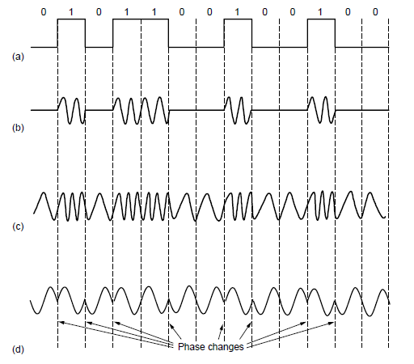
Passband Transmission (1)
Modulating the amplitude, frequency/phase of a carrier signal sends bits in a (non-zero) frequency range
NRZ signal of bits
Amplitude shift keying
Frequency shift keying
Phase shift keying
CN5E by Tanenbaum & Wetherall, © Pearson Education-Prentice Hall and D. Wetherall, 2011

Slide 19
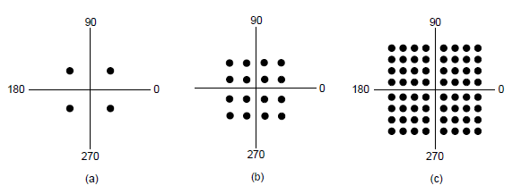
Passband Transmission (2)
Constellation diagrams are a shorthand to capture the amplitude and phase modulations of symbols:
BPSK
2 symbols
1 bit/symbol
QPSK
4 symbols
2 bits/symbol
QAM-16
16 symbols
4 bits/symbol
QAM-64
64 symbols
6 bits/symbol
BPSK/QPSK varies only phase
QAM varies amplitude and phase
CN5E by Tanenbaum & Wetherall, © Pearson Education-Prentice Hall and D. Wetherall, 2011

Slide 20
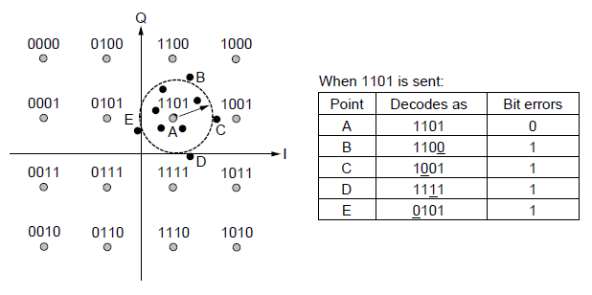
Passband Transmission (3)
Gray-coding assigns bits to symbols so that small symbol errors cause few bit errors:
B
E
A
C
D
CN5E by Tanenbaum & Wetherall, © Pearson Education-Prentice Hall and D. Wetherall, 2011

Slide 21
Digital Encoding Schemes
Nonreturn to Zero (NRZ) and Nonreturn to Zero Inverted (NRZI) Encoding
Manchester Encoding
Differential Manchester Encoding
COSC 439: Computing Network Principles
Notes:
There are a large number of schemes that are available and used to encode digital data as digital signals. The schemes differ in how a ‘0’ or a ‘1’ is represented. Some schemes use a signal level “low” or “high” to represent a data bit. Others use the transition between a high and a low, while other use the existence or non-existence of a transition at the beginning of a bit duration. The we will cover an example of each of these encoding schemes, namely, NRZ, NRZI, Manchester, and Differential Manchester encoding schemes.
→ Next slide

Slide 22
NRZ and NRZI Encoding
NRZ
  0: high
  1: low
  Advantage: Simple
  Disadvantage: Long sequences of 0s may cause discrepancies in signal synchronization
NRZI
  0: no change
  1: change
COSC 439: Computing Network Principles
Notes:
NRZ represents a ‘0’ as high level voltage, and a ‘1’ as a low level voltage. Note, however, that the actual voltage associated with a “high” or a “low” value is not specified. Systems may use a +V, -V or 0V to represent a “high” or a “low” value.
One advantage of the NRZ encoding is it’s simplicity. However, transmission of a long sequence of 0s may cause discrepancies in signal representation. Sending a long sequence of 0s will be equivalent to keeping the voltage level on the transmission link at a “high” level for a long duration. The receiver may not see the same number of 0s as the sender transmitted. This is clearly a synchronization problem.
To illustrate, say the sender transmitted 100 0s and each bit duration is one second. However, if the receiver’s clock ticks just a little bit faster than the sender’s, say, it ticks every 0.99 seconds instead. Then, the receiver will see 101 0s, which is one more than the 100 0s actually transmitted.
NRZI attempts to solve this problem by using a level change to represent a ‘1’ to provide synchronization points and by representing a ‘0’ as no change in the level from the previous bit’s level and a ‘1’ as a change in the level from the previous bit’s level. This means that a long sequence of 0’s may be represented as a long sequence of low level or high level. However, this still does not completely remove the possibility of long durations of high level values on the link.
→ Next slide

Slide 23
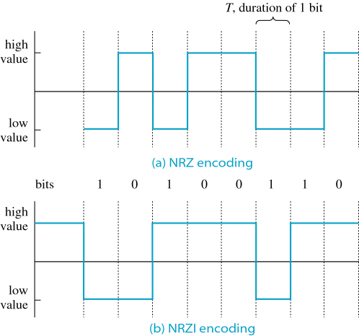
NRZ and NRZI Encoding
COSC 439: Computing Network Principles
Notes:
NRZ encoding id not dependent on the level of the previous signal sent. NRZI, on the other hand, has to know the level of the previous signal to be able to either change the level of the signal at the beginning of the bit time (‘1’) or to remain at the same level (‘0’).
→ Next slide

Slide 24
Manchester Encoding
Uses signal changes to keep the sending and receiving devices synchronized
0: high-to-low
1: low-to-high
Advantage:
  self-synchronizing code
Disadvantage:
  Requires twice the bandwidth
COSC 439: Computing Network Principles
Notes:
Both the Manchester and Differential Manchester encoding schemes introduce a level transition in the middle of the bit duration. These encoding schemes are clearly not susceptible to the discrepancies that may be introduced in encoding long sequences of the same bit. The transitions facilitate the synchronization between the sender and receiver. However, due to the need to encode each bit as two levels, these schemes require twice as much bandwidth as the NRZ/I schemes.
Manchester encodes a ‘0’ as a transition from high to low in the middle of the bit duration while a ‘1’ is encoded as a transition from low to high in the middle of the bit duration.
→ Next slide

Slide 25
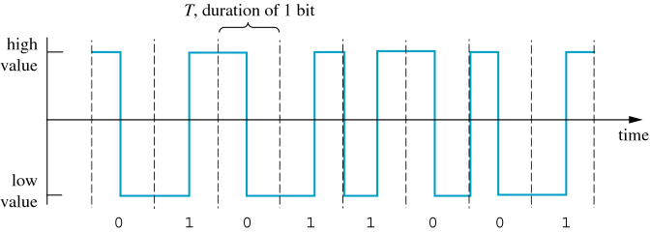
Manchester Encoding
COSC 439: Computing Network Principles
Notes:
This example illustrates the Manchester encoding.
All ‘0’ bits start at the high level and then transition to a low level.
All ‘1’ bits start at the low level and transition to a high level.
→ Next slide

Slide 26
Differential Manchester Encoding
0: change in signal at the start of the interval
1: causes the signal to remain where it was at the end of the previous interval
COSC 439: Computing Network Principles
Notes:
Differential Manchester encoding represents bits by the transition (‘0’) or non-transition (‘1’) of the signal level at the beginning of the bit duration and then a transition in the middle of the bit duration.
→ Next slide

Slide 27
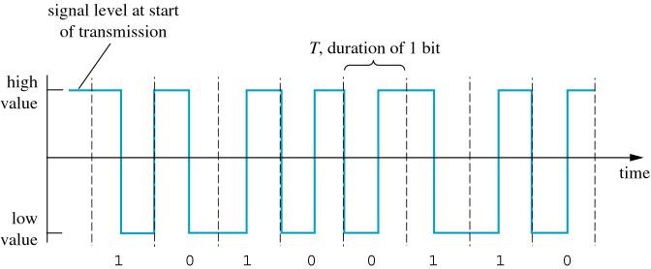
Differential Manchester Encoding
COSC 439: Computing Network Principles
Notes:
The level of the previous signal is needed in order to encode data in Differential Manchester.
In the given example, we assume that the previous level was high, therefore a ‘1’ will maintain the same level at the beginning of the bit duration and then transition to a low level in the middle.
The second bit ‘0’ transitions from the low level of the previous signal to a high level at the beginning of the bit duration, followed by another transition in the middle. Note that the transitions in the middle of the bit duration may not be the same for different instances of the same bit value.
→ Next slide

Slide 28
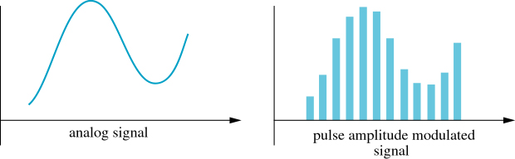
Analog to Digital Conversion
Pulse Amplitude Modulation (PAM)
COSC 439: Computing Network Principles
Notes:
Given analog data such as the human voice, we can convert it into digital form using various conversion techniques. One such technique is pulse amplitude modulation (PAM). The figure given illustrates how an analog signal can be sampled at regular intervals to convert it into digital form. The sampled analog signal’s amplitude is measured and then a pulse with amplitude equal to that of the sampled signal is generated.
→ Next slide

Slide 29
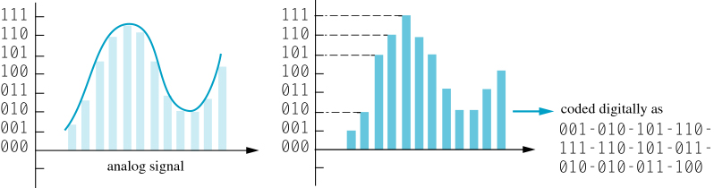
Analog to Digital Conversion
Pulse Code Modulation (PCM)
  Accuracy
    Sampling frequency
    Quantization noise
COSC 439: Computing Network Principles
Notes:
Another technique is called pulse code modulation (PCM) which represents the sampled amplitude value from a set of predefined n-bit binary values. The amplitude range is divided into a set of 2^{n} amplitudes and an n-bit binary number is associated with each one.
The sampled value is rounded to the closest one of the pre-set 2^{n} amplitudes and encoded using the corresponding n-bit value. This rounding off to a pre-set amplitude introduces quantization noise.
→ Next slide

Slide 30
Analog to Digital Conversion
Differential Pulse Code Modulation (DPCM)
COSC 439: Computing Network Principles
Notes:
A variation of the PCM technique is the differential pulse code modulation (DPCM). In DPCM, the encoded value is the difference in the values of the associated 2^{n} amplitude of the previous and the current sampled amplitudes.
If we take the same analog signal given in the previous slide and encode the difference as a 3-bit signed magnitude string, then the corresponding encoded data is:
001 – 011 – 001 – 001 – 101 – 101 – 110 – 101 -- 000 – 001 -- 001
→ Next slide

Slide 31
Modulation and Demodulation
Modem: a device that converts digital signals to analog (modulation) and vice versa (demodulation)
COSC 439: Computing Network Principles
Notes:
Digital to analog conversion and vice versa is used in most communication between computers and the Internet using the telephone system, cable television system or satellites.
We will cover various techniques for representing digital signals into analog signals by varying the analog signal’s frequency, amplitude, and phase shift.
→ Next slide

Slide 32
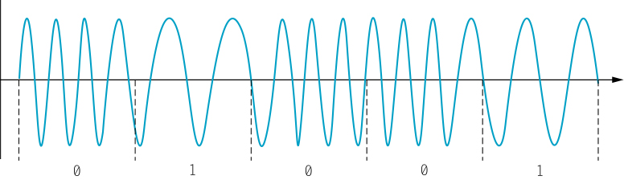
Digital to Analog Conversion
Frequency Modulation
  Or Frequency Shift Keying (FSK)
  FSK (2 Frequencies), 1 bit per baud
COSC 439: Computing Network Principles
Notes:
Frequency modulation (FM) or frequency shift keying (FSK) assigns a digital value to an analog frequency. For example, a bit ‘0’ may be assigned a higher frequency f₀ and a bit ‘1’ may be assigned a lower frequency f₁ as shown in the figure. Therefore, the two analog signals can be represented as:
s₀(t) = A sin (f₀t + θ)
s₁(t) = A sin (f₁t + θ)
Using only 2 frequency values, 1 frequency per bit, generates a bit rate equal to the baud rate. If we use more frequencies, say, 4 different frequencies: f₁, f₂, f₃, f₄, we can assign a 2-bit string to each frequency. That is, an analog signal using f₁ represents the bit string ‘00’, f₂ represents ‘01’, f₃ represents ‘10’, and f₄ represents ‘11’. This then gives us a bit rate that is twice the baud rate.
s₀₀(t) = A sin (f₀₀t + θ)
s₀₁(t) = A sin (f₀₁t + θ)
s₁₀(t) = A sin (f₁₀t + θ)
s₁₁(t) = A sin (f₁₁t + θ)
We can further extend this by using 2^{n} different frequencies, and assign each frequency to an n-bit string. This results in bit rate = n * baud rate.
→ Next slide

Slide 33
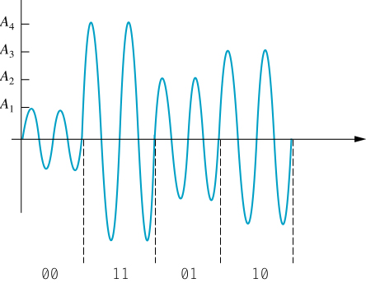
Digital to Analog Conversion
Amplitude Modulation
  Or Amplitude Shift Keying (ASK)
  ASK (4 Amplitudes), 2 bits per baud
COSC 439: Computing Network Principles
Notes:
Amplitude modulation (AM) or amplitude shift keying (ASK) assigns a bit to a given analog signal amplitude (magnitude). If we use two amplitude values and assign a bit to each amplitude, we generate a bit rate equal to the baud rate.
s₀(t) = A₀ sin (ft + θ)
s₁(t) = A₁ sin (ft + θ)
If we use 4 different amplitudes: A₁, A₂, A₃, and A₄, we can assign a 2-bit string for each of the amplitudes. In the figure given, the bit string ‘00’ uses A₁, ‘01’ uses A₂, ‘10’ uses A₃, and ’11’ uses A₄.
s₀₀(t) = A₀₀ sin (ft + θ)
s₀₁(t) = A₀₁ sin (ft + θ)
s₁₀(t) = A₁₀ sin (ft + θ)
s₁₁(t) = A₁₁ sin (ft + θ)
One thing to note is that we cannot use an unlimited number of amplitudes to represent long binary strings since we are limited by the range of the magnitude of the analog signal. In addition, using a large number of amplitudes eventually forces the difference between values to be too small such that the introduction of noise will distort most of the data, converting a legitimate analog signal into another legitimate analog signal. (Refer to Slide #17)
→ Next slide

Slide 34
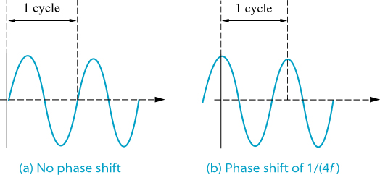
Digital to Analog Conversion
Phase Modulation
  Or Phase Shift Keying (PSK)
  Differential Phase Shift Keying
  Effect of Shift on a Signal
COSC 439: Computing Network Principles
Notes:
Phase modulation (PM) or phase shift keying (PSK) uses the signal’s phase shift (relative to t=0) to represent a binary string. The figure illustrates how a bit ‘0’ may represent no phase shift, while a bit ‘1’ may represent a phase shift of 1/(4f).
s₀(t) = A sin (ft + θ₀)
s₁(t) = A sin (ft + θ₁)
In general, we can define 2^{n} different phase shifts, and assign each phase shift to an n-bit binary string.
A variation of PSK is Differential Phase Shift Keying (DPSK) which measures the phase shift relative to the previous signal.

Slide 35
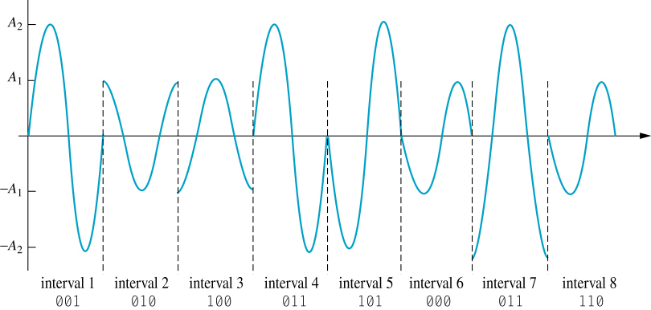
Digital to Analog Conversion
Quadrature Amplitude Modulation (QAM)
  A group of bits is assigned a signal defined by its amplitude and phase shift
  QAM (2 Amplitudes and 4 Phases), 3 bits per baud
COSC 439: Computing Network Principles
Notes:
Quadrature Amplitude Modulation (QAM) uses a combination of amplitude and differential phase shift to represent a group of bits.
In the figure given, two amplitude values (A1 and A2) and 4 phases (0, π/2, π, and 3π/2) are used to define 3-bit binary strings.
s₀₀₀(t) = A₁ sin (ft + 0)
s₀₀₁(t) = A₂ sin (ft + 0)
s₀₁₀(t) = A₁ sin (ft + π/2)
s₀₁₁(t) = A₂ sin (ft + π/2)
s₁₀₀(t) = A₁ sin (ft + π)
s₁₀₁(t) = A₂ sin (ft + π)
s₁₁₀(t) = A₁ sin (ft + 3π/2)
s₁₁₁(t) = A₁ sin (ft + 3π/2)
→ Next slide

Slide 36
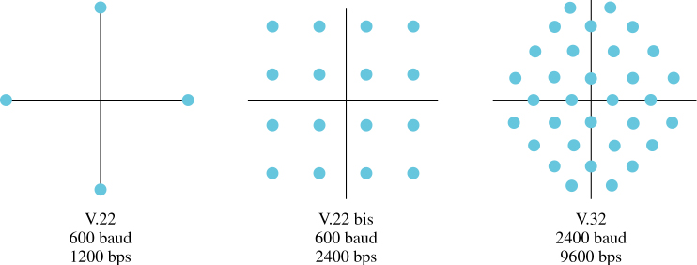
Modems and Modem Standards
Signal Constellations
  V.22, V.22bis and V.32
COSC 439: Computing Network Principles
Notes:
The V Series modem standards is designated by the ITU-T. Each standard uses a different baud rate, bits per baud, and modulation technique. Given the constellation pattern for the V.22 standard, with 4 constellation points at different phases, we can see that it uses 2 bits per baud and uses PSK. At 600 baud and 2 bits per baud, the bit rate is 2*600 = 1200 bits per second
The 16 constellation points on the V.22 bis standard are located at different distances (amplitude) from the origin and different phases, which indicates QAM as the modulation technique. The 16 points correspond to 4 bits per baud which gives us a bit rate of 4 * 600 baud = 2400 bits per second.
The V.32 standard defines 32 constellation points also at different amplitudes and phases (QAM). The standards uses only 4 of the 5 bits per baud for data and uses one bit for error detection/correction functionality. This gives a data rate = 4 * 2400 = 9600 bits per second.
A design issue for choosing the location of the points in the constellation pattern is how close a signal representing each point will be to another point if amplitude or phase distortion is introduced to the signal.
→ Next slide

Slide 37
Cable Modems
Designed to connect with the analog components of a cable TV (CATV) provider
Computer requires a network card to communicate with cable modem
Adv: No need to dial in
Disadv: Bandwidth shared with many users
Uses QPSK or QAM64
COSC 439: Computing Network Principles
Notes:
The maximum bit rate that can be provided by dial-up modems and conventional telephone lines is limited to 56Kbps. Cable modems are designed to connect you to the Internet via cable TV (CATV) signals. Because of the higher frequency capacity of cable TV, higher bit rates are available for transmission. In addition, there is no need to dial-up because the connection is always there.
CATV signals range up to about 750 MHZ, which is divided into 6-MHz bands for individual station channels. Each channel can carry up to 36 Mbps, which is shared among your neighborhood using some form of time division multiplexing (to be covered in Chapter 4).
Most cable modem services provide asymmetric transmission, with higher download data rates and lower upload data rates. To facilitate the high bit rate requirements for downloading, typical modulation techniques used are Quaternary PSK or QAM64. Upload data are modulated using PSK.
Cable modem standards are still being developed by the IEEE 802.14 Working Group.
→ Next slide

Slide 38
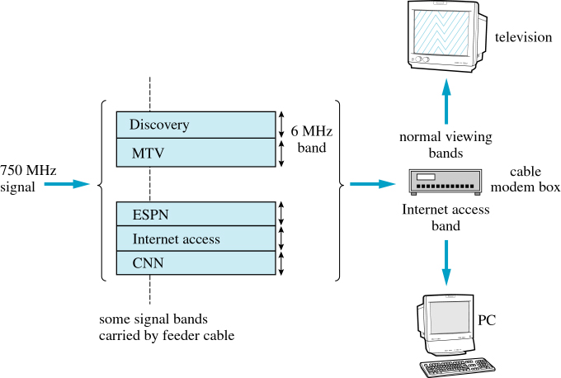
Cable Modem and Carrier Signals
COSC 439: Computing Network Principles
Notes:
The cable modem connects to the CATV wall jack to which a computer’s network card can be connected using Cat 5 UTP. The cable modem converts analog signals coming from the Internet access band (channel) to digital and sends it to the computer’s network card. It will also convert digital signals received from the computer’s network card into analog signals to be carried over the CATV Internet access channel. Note that separate bands may be used for the uploading and downloading.
→ Next slide

Slide 39
xDigital Subscriber Line (xDSL)
Uses existing telephone lines in the local loop at higher frequencies
Various technologies (xDSL)
Asymmetric DSL (ADSL)
  Uses two filters to separate low-frequency and high frequency signals
  Uses discrete multitone technology
    Divide frequency range into 256 channels
    Divide among POTS, upstream and downstream transmission, separated by guard bands
COSC 439: Computing Network Principles
Notes:
xDigital Subscriber Line (DSL) uses the same telephone lines in the local loop but uses higher frequencies. Unlike conventional modems used for dial-up, xDSL modems allow for the connection to always be there and for the telephone to be used at the same time.
There are various DSL technologies that have been developed, hence the ‘x’ in xDSL. One of these is Asymmetric DSL (ADSL) where the bit rate for uploading is lower the the bit rate for downloading. In ADSL, the use of higher frequencies is made possible by installing a DSL access multiplexer (DSLAM) at the local office. A splitter is receives both the lower frequencies for voice communication and the higher frequencies for high speed Internet service from the customer site. It forwards the high frequency signals to the DSLAM and the low frequency signals to the telephone network.
At the customer site, a splitter/filter and an ADSL modem is needed. The splitter uses a high-pass filter to separate the high frequency (> 4Khz) signals and forward to the ADSL modem. The splitter also uses a low-pass filter to filter the low frequency signals and forward it to the telephones.
The modulation technique used in ADSL is called discrete multitone. The frequency range from 0 to 1.104MHz is divided into 256 channels or tones, each with a bandwidth of 4.3125 kHz. It uses the lowest 5 channels for carrying telephone signals and the rest for upstream and downstream high speed internet service. Since the condition of the line connecting a customer to the local office varies (it uses existing wiring), ADSL adjusts the use of the channels by using different (QAM) modulation techniques for each channel based on its signal-to-noise ratio levels. That is, some channels with better signal-to-noise ratio may carry more bits than others. The channels carry groups of data bits and transmit them at the same time.
Available data rates for a subscriber may differ based on the distance to a local office. Data rates up to 6.1 Mbps may be possible. However, more typical data rates are from 512 Kbps to 1.544 Mbps downstream and about 128 Kbps upstream. Since the signal degrades over distance, some telephone subscribers who are more than 3.5 mies from the local office may not receive DSL service.
Other technologies include HDSL (High-bit-rate symmetrical DSL), RADSL (Rate-adaptive ADSL), etc. Each technology may use different modulation techniques, require additional infrastructure, etc.
→ Next slide

Slide 40
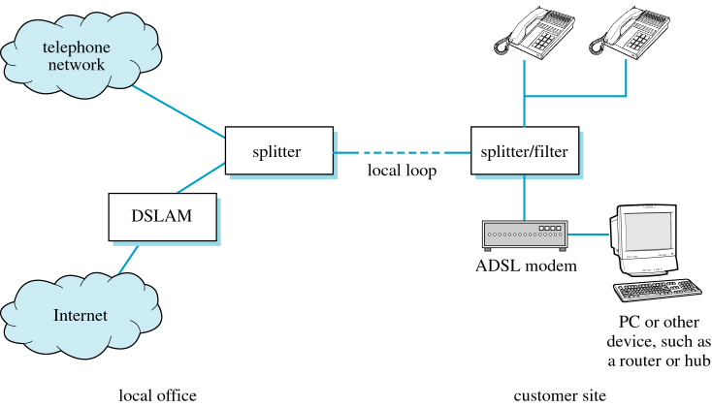
ADSL Connection
COSC 439: Computing Network Principles
Notes:
The figure illustrates the required configuration for providing ADSL service.
→ Next slide

Slide 41
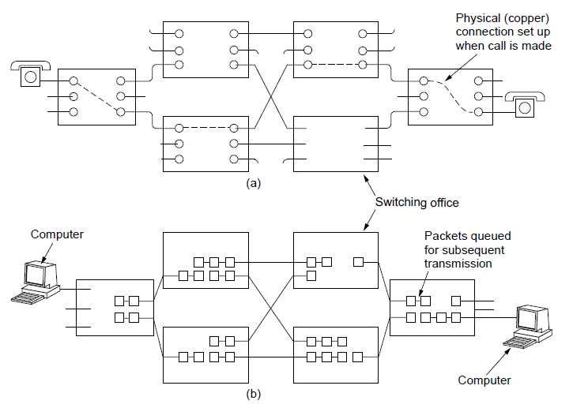
Switching (1)
PSTN uses circuit switching; Internet uses packet switching
PSTN:
Internet:
CN5E by Tanenbaum & Wetherall, © Pearson Education-Prentice Hall and D. Wetherall, 2011

Slide 42
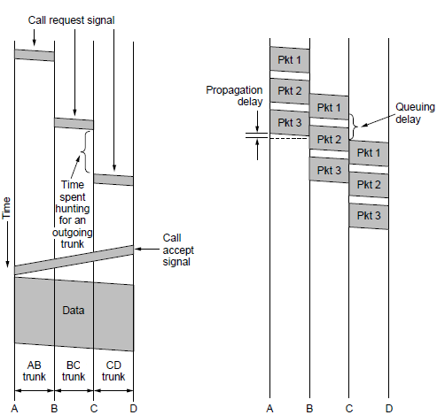
Switching (2)
Circuit switching requires call setup (connection) before data flows smoothly
  Also teardown at end (not shown)
Packet switching treats messages independently
  No setup, but variable queuing delay at routers
Circuits
Packets
CN5E by Tanenbaum & Wetherall, © Pearson Education-Prentice Hall and D. Wetherall, 2011

Slide 43
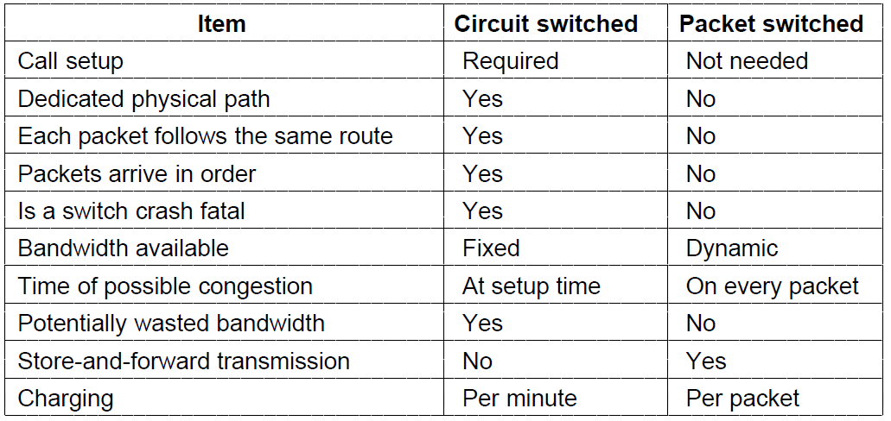
Switching (3)
Comparison of circuit- and packet-switched networks
CN5E by Tanenbaum & Wetherall, © Pearson Education-Prentice Hall and D. Wetherall, 2011

Slide 44
Reading Assignment
Chapter 3: Data Link Layer
COSC 439: Computing Network Principles

